Slide 1
Standard Template Libraries (STL) of C++
Tasmin Sanjida
United International University

Slide 2
Standard Template Libraries (STL) of C++
The Standard Template Library (STL) is a set of C++ template classes to provide common programming data structures and functions such as
Stacks
Array
Vectors
Lists
Map and Set
Algorithms(sort, find, count_if)

Slide 3
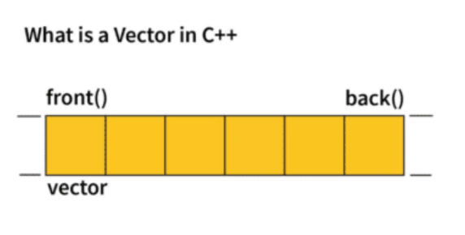
Vectors
Vectors are dynamic arrays that can grow or shrink in size.
Ability to resize itself automatically when an element is inserted or deleted
They provide constant time access to elements and dynamic resizing.

Slide 4
Vector
Need to include the <vector> header in C++ program to use vectors
#include <vector>
Declaring Vectors
std::vector<dataType> vectorName;
Initializing Vectors
std::vector<int> userVector = {1, 2, 3, 4, 5};
Print vector elements
for (int num : anotherVector) {
std::cout << num << " ";
}

Slide 5
Modifiers of a Vector
You can add elements to a vector using the push_back() method | vectorName.push_back(element);
You can remove elements from a vector using the pop_back() method | vectorName.pop_back();
You can assigns new values to the vector elements, replacing the old ones using the assign() method | vectorName.assign({element1, element2, element3});

Slide 6
Modifiers of a Vector
insert():Inserts new elements before the element at the specified position. | vectorName.insert(index, element);
erase():Removes elements from the specified position or range | vectorName.erase(index);
swap():Swaps the contents of one vector with another vector of the same type(Sizes can differ) | vector1Name.swap(vector2Name);

Slide 7
Modifiers of a Vector
clear():Removes all elements from the vector. | vectorName.clear();
emplace():Extends the container by inserting a new element at the specified position. | vectorName.emplace(index, element);
emplace_back():Inserts a new element into the vector container, adding it to the end. | vector1Name.emplace_back();

Slide 8
Capacity of a Vector
size() – Returns the number of elements in the vector.
max_size() – Returns the maximum number of elements that the vector can hold.
capacity() – Returns the size of the storage space currently allocated to the vector expressed as number of elements.
resize(n) – Resizes the container so that it contains ‘n’ elements.
empty() – Returns whether the container is empty.
shrink_to_fit() – Reduces the capacity of the container to fit its size and destroys all elements beyond the capacity.
reserve() – Requests that the vector capacity be at least enough to contain n elements.

Slide 9
Problem 01
Write a C++ program that take input from users and capitalize the first character of each element of a given string vector. Don't create any new function.
How many words? 3 grapes are sour | Grapes Are Sour
How many words? 5 it is a famous place | It Is A Famous Place

Slide 10
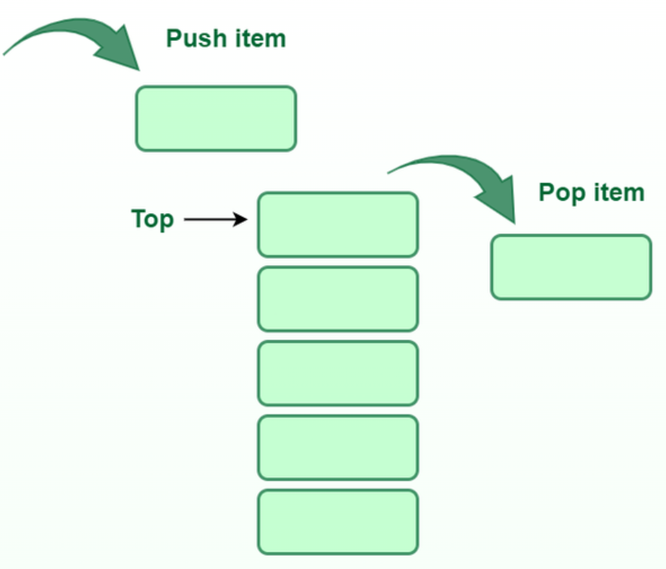
Stack
In C++, the stack is a container that follows the Last In, First Out (LIFO) principle. It means that the element that is added last is the first one to be removed.
Need to include the <stack> header to use the stack in C++
#include <stack>
Declaring a Stack:
stack<dataType> stackName;

Slide 11
Functions associated with Stack
empty() – Returns whether the stack is empty | stackName.empty();
size() – Returns the size of the stack | stackName.size();
top() –To access the top element without removing it | stackName.top();
push(element) – To add an element to the top of the stack | stackNsmr.push(element);
pop() – Deletes the top element from the stack | stackName.pop();

Slide 12
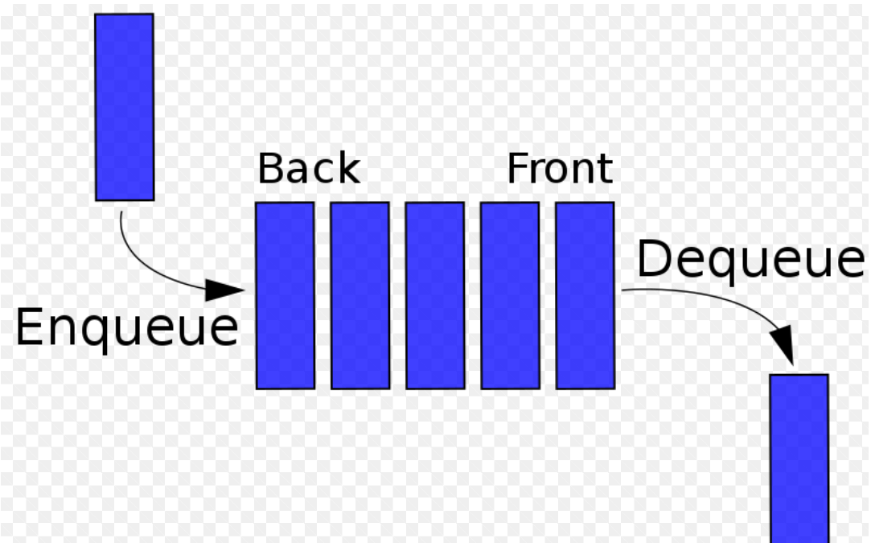
Queue
A queue is a container that follows the First In, First Out (FIFO) principle. It means that the element that is added first is the first one to be removed.
To use the queue in C++, include the <queue> header
#include <queue>
Declaring a Queue
queue<int> myQueue;

Slide 13
Queue
Enqueue(push) : To add an element to the back of the queue, use the push function | queueName.push(element);
Dequeue (Pop): To remove the front element from the queue, use the pop function | queueName.pop();
Front: To access the front element without removing it, use the front function | queueName.front();
Back: Returns a reference to the last element of the queue | queueName.back();
Empty: To check if the queue is empty, use the empty function | queueName.empty();

Slide 14
Queue
Size : To get the number of elements in the queue, use the size function | queueName.size();
swap(): Exchange the contents of two queues but the queues must be of the same data type, although sizes may differ. | firstQueue.swap(secondQueue);
emplace(): Insert a new element into the queue container, the new element is added to the end of the queue. | queueName.emplace("Hello"); queueName.emplace("World");

Slide 15
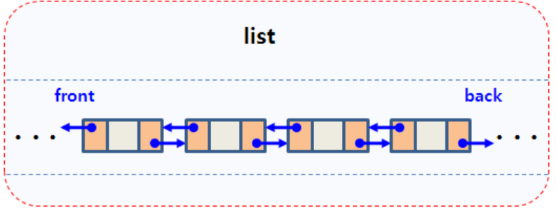
List
A list is a container provided by the Standard Template Library (STL) that implements a doubly-linked list.
Need to include the <list> header
#include <list>
Declaration
std::list<dataType> listName;

Slide 16
List
Initialization | std::list<dataType> listName = {element1, element2, element3, .....};
front(): Returns the value of the first element in the list. | listName.front();
back(): Returns the value of the last element in the list. | listName.back();
push_front(): Adds a new element at the beginning of the list. | listName.push_front(element);
push_back(): Adds a new element at the end of the list. | listName.push_back(element);

Slide 17
List
pop_front(): Removes the first element of the list and reduces the size by 1. | listName.pop_front();
pop_back(): Removes the last element of the list and reduces the size by 1. | listName.pop_back();
insert(): Inserts new elements in the list before the element at a specified position. | listName.insert(index, element);
size(): Returns the number of elements in the list. | listName.size();
begin(): Returns an iterator pointing to the first element of the list. | listName.begin();
end(): Returns an iterator pointing to the theoretical last element which follows the last element. | listName.end();

Slide 18
Explore More...

